Slide 1
Oxidative Stress & Neural Damage Parameters in Parkinson’s Disease
06/04/2021
Abdülhamit Ali

Slide 2
TABLE OF CONTENTS
01
04
02
05
03
Introduction
Results
Background & Diagnosis of PD
Aim of the Study
Conclusion
Pathophysiology & Parameters
06
Methods
Discussion

Slide 3
PREVELANCE
Parkinson’s Disease is the second most common neurodegenerative disorder
In the United States, at least half a million people are diagnosed as having PD
Frequency of PD is predicted to triple over the next 50 years as the average age of the population increases
10,000,000
PD patients worldwide

Slide 4
DIAGNOSIS
Diagnosis of PD almost only depends on the presence of motor & non-motor symptoms
Hallmark motor symptoms include:
-Bradykinesia
-Resting tremor
-Rigidity
-Postural instability
Non-motor symptoms:
-Orthostatic hypotension
-Anxiety/Depression
-Sleep disorders
-Dementia

Slide 5
PRODROMAL STAGE
Blink Rate
Constipation
Urinary/Sexual Dysfunction
REM Sleep Disorder

Slide 6
STUDY PURPOSE
Our study sought to discover possible biochemical parameters to ease the diagnosis of PD, thus prevent a further degeneration on the dopaminergic neurons
Early diagnosis can lead to early treatment, so the detection of these markers is an objective, effective and timely auxiliary diagnosis method
The parameters might also be useful to determine the prognosis and severity of the disease

Slide 7
PATHOPHYSIOLOGY
The selected biomarker for the early diagnosis should be closely related to the pathological process of the disease.
Oxidative Stress
Progressive loss of
DA neurons in SNpc
Accumulation of
Lewy bodies

Slide 8
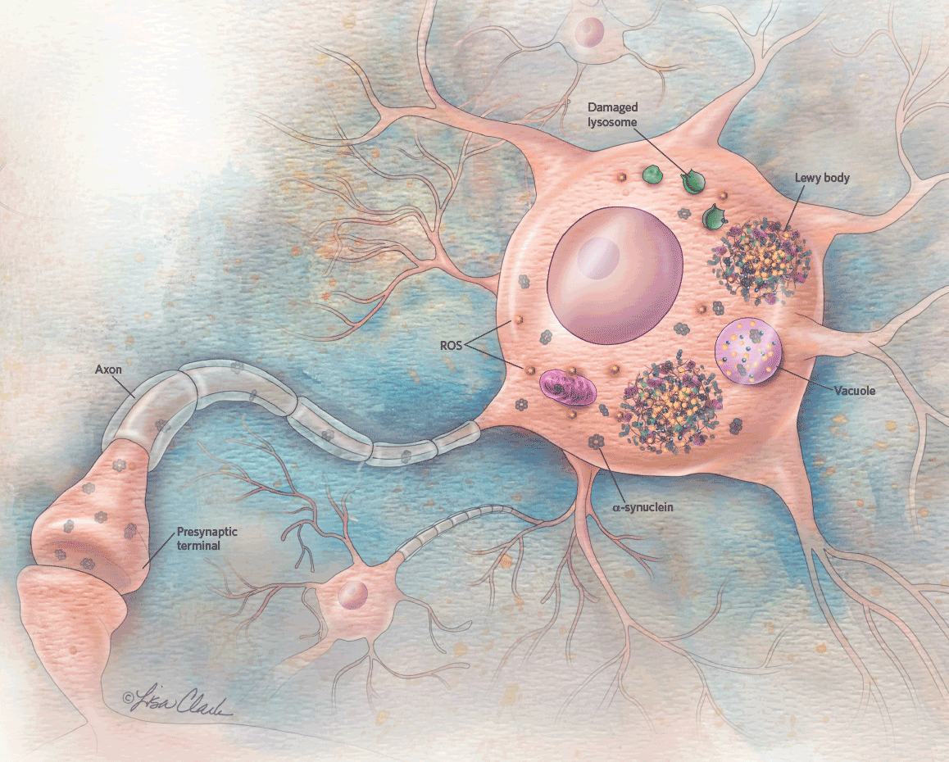
PARAMETERS
Major component of Lewy bodies, and its oligomers
mediate its toxic effects on dopaminergic neurons and even on
non‐dopaminergic neurons
Autopsy investigations have shown abnormal iron deposition in the substantia nigra of PD patients
TAS
Play an important role in familial PD, might be effective in the early diagnosis of PD
a-synuclein
Iron
LDL&HDL
TOS
TG
Total oxidant status (TOS) and total antioxidant status are indicators of oxidative stress

Slide 9
METHODS
Patient Profile
AGE: 40-65
MEDICAL Hx: PD patients without any other neurological conditions
32 Male / 30 Female
62 PD patients and 62 healthy individuals were enrolled in the study who admitted to Bezmialem Vakıf University neurology outpatient clinic between October 2017-May 2020.
Participants did not have any other neurological disease that could affect the level of parameters.
The medical history of the patients, including duration of the disease, the treatment modality of PD and chronic diseases are taken.
Patients undergone a detailed neurological examination and their stage on Hoehn and Yahr scale is determined according to the PE findings.
The control group is matched with the experimental group in terms of age and sex
Notes:
Bezmi su yastalar , su tarihler arasi

Slide 10
METHODS
A venous blood sample was collected in a fasting condition and centrifuged, and the supernatant was collected within 15 minutes.
The plasma level of α‐synuclein oligomer was determined by means of the enzyme‐linked immunosorbent assay (ELISA) double‐antibody sandwich method.
The Iron, cholesterol and TG levels are measured using Ferene, Enzymatic and Glycerol phosphate oxidase methods respectively.
The plasma levels of TAS and TOS are measured via automated calorimetric method.

Slide 11
STATISTICS
Data were analysed using statistical software SPSS 20.0.
Independent sample t test was used to determine whether there was a statistical difference in plasma levels of parameters between the experimental and control groups.
The results are also statistically compared within the experimental group in terms of the duration of the disease, treatment methods, and Hoehn-Yahr scale using Spearman’s Rho test.

Slide 12
RESULTS
The plasma levels of αSyn oligomer in patients were significantly higher than healthy individuals. (P < 0.001).
Plasma Fe levels are significantly lower in the experimental group (P <0.05).
Positive correlation between the duration of the PD and plasma αSyn, LDL levels are found in the experimental group (P <0.05).
The LDL levels of PD patients who are treated with dopaminergic agents (DA agonists, L-dopa) were significantly lower compared to other treatment modalities.

Slide 13
RESULTS
a-synuclein | FE | LDL | HDL
TG | TAS | TOS
**
*
Control vs Pts
H&Y Scale
*
*
Duration of PD
Treatment Modality
*
P values
<0,001**
<0,05*
<0,05*
-
-
-
-
Table: Statistical significance of comparisons are shown above

Slide 14
CONCLUSION
01
02
Plasma αSyn and Fe levels might be
helpful in the early diagnosis of PD.
A high level of αSyn and LDL may
illustrate more severe prognosis of
the disease.

Slide 15
LIMITATIONS
Although the levels of a-synuclein do not alter significantly due to pathological and physiological reactions in the body, the majority of the parameters do.
Iron and LDL levels also depend on the age, gender and diet of patients.
The participants are from one academic medical center

Slide 16
DISCUSSION
Funding:BAP
A-synuclein is the most promising parameter to help the diagnosis of PD
More research studies are needed to insert possible parameters into the diagnostic guidelines
Although measuring certain parameters help, the diagnosis of PD likely to remain mostly clinical

Slide 17
RESEARCH TEAM
Hamit Ali
Medical Student
Tuğçe Yıldız
MD
Gülsen Babacan
MD,Mentor

Slide 18
THANKS
Does anyone have any questions?
hamitali977@gmail.com
+90 537 792 8101

